Slide 1

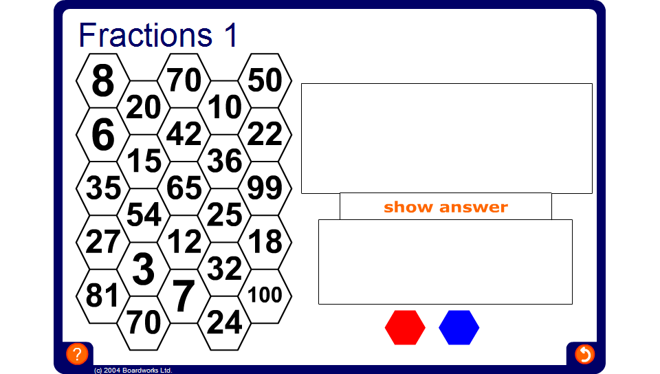


MathsBlox
Notes:
Divide the class into two teams – red and blue – and nominate a spokesperson for each team.
The spokesperson from the first team chooses a number on the grid. A question appears when the number is selected and everyone on that team must try to work out the answer. They may use jottings if they wish. Select a member of the team at random to give you their answer (if they pass the hexagon is coloured in the opposing team’s colour).
Click on the ‘show answer’ button. If it is correct, colour the hexagon in the team colour if it is incorrect the hexagon is coloured in the opposing team colour. Spend a few moments discussing mental strategies to answer the question.
Play then passes to the other team.
The winning team is the first team to connect a line of hexagons either from top to bottom or from left to right.

